Slide 1
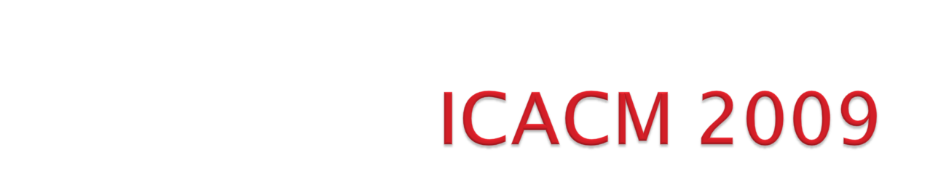
Organizational meeting
26 September 2008

Slide 2
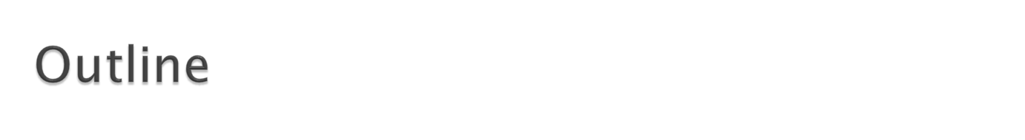
Background of ICACM
ICACM 2009
  Details (dates, funding, etc)
  Topics
  Committees
  Tentative list of speakers
Discussion

Slide 3

Objective: promote research partnership between US & FR in applied computational mechanics
Initial discussions: 2005
ICACM symposia
  2007: Bridging Scales in Computation (UF-REEF, Shalimar, FL, US)
  2008: Materials under extreme loadings (DGA, Rocamadour, FR)
  2009: Damage and fracture in heterogeneous materials and structures (UF-REEF, US)
  2010: Topic and specific location to be determined by FR (Paris XIII, FR)
  2011: Joint IUTAM/ICACM Symposium on Multi-scale modeling (UF/REEF, US) – need to consider approach.

Slide 4

1st US-FR Symposium:
Advances in Bridging Scales in Computation From Microstructure to Macro-Scale Properties of Heterogeneous Materials, March 28-30, 2007 - Shalimar, FL
• Funding: AFOSR (Computational Mathematics)
• 40 participants, 2/3 French
• 28 presentations, 12 keynote speakers, 10 US presentations
• 90% of participants were speakers:
• Keynote speakers: 45 minutes
• Invited speakers: 30 minutes
• Registration, welcome reception, banquet, breakfast, lunch,
lodging: free for FR participants only

Slide 5


ICACM 2007 Book: Multiscale Modeling of Heterogenous Materials
From microstructure to macro-scale properties
Overview of recent advances in
computational methods for linking phenomena
in systems that span large ranges of time and
spatial scales.
Contents: selected papers presented at ICACM 2007
ISBN: 9781848210479
Publication Date: August 2008 Hardback 368 pp.
70.00 GBP, 110.00 EUR, 140.00 USD
To order: http://www.iste.co.uk/index.php?a=i&ACTION=Static&Page=ordering
Authors are entitled to 30% discount

Slide 6

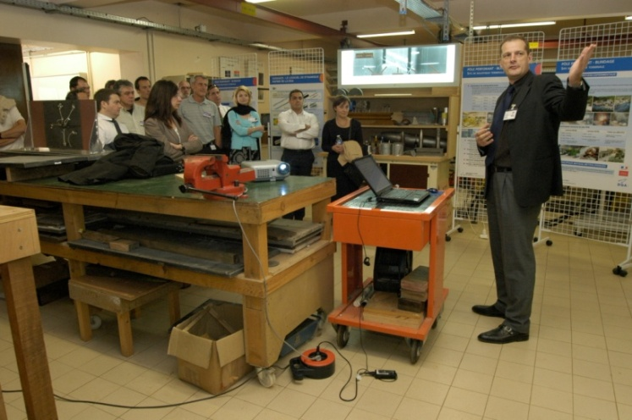
2nd US-FR Symposium:
MATERIALS UNDER EXTREME LOADINGS - APPLICATION
TO PENETRATION AND IMPACT
28-30 May 2008 Hôtel du Château Rocamadour,
France
Funding: DGA/UM-MID + CNRS + DYMAT
61 participants, 1/3 US
29 presentations, 10 keynote speakers, 17 US talks
90% of participants were speakers:
Keynote speakers: 40 minutes
• Invited speakers: 25 minutes
• Registration, welcome reception, banquet, breakfast, lunch, lodging: free
ICACM 2008 CD-ROM containing: list of participants, all presentations, photos
ICACM 2008: BOOK (to be discussed)

Slide 7
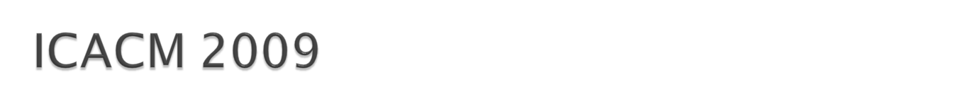
Title:
DAMAGE AND FAILURE IN HETEROGENEOUS MATERIALS AND STRUCTURES
22 – 24 April 2009, UF-REEF, Shalimar, Florida
60 participants, 2/3 FR, by invitation only
24 presentations, 10 keynote speakers, 7 US talks
Funding: AFOSR/AFRL
Keynote speakers: 40 minutes
• Invited speakers: 25 minutes
• Registration, welcome reception, banquet, breakfast, lunch, lodging: free for FR participants
Other: Website, poster NLT 90 days prior
Proposal presentation to the ICACM executive advisory board: 26 September 2008
Notes:
$300 registration fee to cover banquet, reception, 3 lunches, 3 breakfasts, snacks.
Lodging for French speakers to be covered by US (4 nights).
Need $ for DOCE fee.

Slide 8
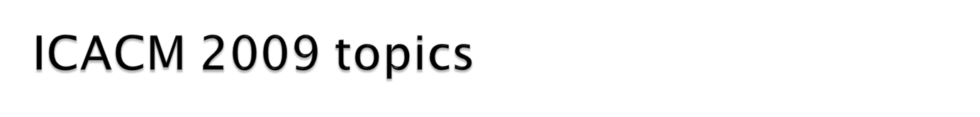
Ductile damage
Ductile damage at ambient temperatures and quasi-static loadings
novel developments in experimental identification and characterization of dissipative mechanisms ; bridging scales techniques: (Homogenization methods, FE based methods; novel limit analysis methods) ; strain rate effects; texture effects
Fatigue damage
Damage in geomaterials
Micromechanics of porous media with evolving microstructure and modeling of the related transport properties
Instabilities, bifurcation phenomena
Chemo-mechanical damage
Degradation due to chemical agents
Impact on durability of materials and structures

Slide 9

Proposed Scientific committee
Dr. R. Dormeval, Fr, CEA, DYMAT, FR
Eric Buzaud, DGA
Dr. R.A. Lebensohn, Los Alamos National Lab, AFRL, US
Pr. J-B. Leblond, Fr, Paris VI, FR
Dr. B. Patterson, AFRL, US
Univ Joseph Fourier, FR
Univ Lille, FR
Paris XIII, FR
Univ Savoie, FR
Pr. G. Voyadjis, LSU, US
…….
Local organizing committee:
Pr. J. Rogacki, Dr. O. Cazacu, J. Lusk

Slide 10

1 | P. Suquet | Lab de Mecanique et d’Acoustique (LMA), CNRS, Marseille, FR
2 | J-B Leblond | Lab modelisation en Mecanique, (LMM), Paris Vi, FR
3 | P. Gilormini | Ecole Nationale Superieure d’Arts et Metiers, (ENSAM) Paris, FR
4 | F. Darve | Lab 3S-R, Grenoble, FR
5 | D. Kondo | Univ Lille, FR
6 | J. Besson | Ecole de Mines Paris, (EMP), FR
7 | J-L Chaboche | ONERA
8 | P. Ponte-Castaneda | Univ. Pennsylvania US
9 | C. N. Tome | Los Alamos, US
10 | J.Y. Yoon | Alcoa, US

Slide 11
11 | S. Gosh | Ohio State Univ, US
12 | N. Triantafyllidis | Univ Michigan, US
13 | V. Monchiet | Univ Marne-la Valee, FR
14 | E. Darve | Stanford Univ, US
15 | A. Constantinescu | LMS, FR
16 | J.W. JU | UCLA, US
17 | E. Maire | Ecole de Mines Paris, (EMP), FR
18 | J. Desrues | CNRS, Lab 3S-R, Grenoble, FR
19 | M. Bornert | LMS
20 | A. Benzerga | Texas A & M, US
21 | G. Kaschner | Los Alamos, US

Slide 12
22 | G. Pijaudier-Cabot | University of pau
24 | L. Dormieux | ENPC
25 | J.J. Marigo | Paris VI
26 | F. Hild | LMT
27 | N. Moes | ECN
28 | F. Morel | University of Angers
29 | J. Pastor | Chambery
30 | A. Chrysochos | University of Montpellier
31 | E. Charkaluk | Lille
32 | A. Delaplace | LMT Cachan
33 | F. Radjal | Univesrity of Montpellier

Slide 13
34 | S. Li | UC Berkeley

Slide 14
DISCUSSION

Slide 15

Send recommendations regarding additional keynote and invited speakers to O. Cazacu by 3 October (ALL)
Send recommendations regarding scientific committee members to O. Cazacu by 3 October (ALL)
Send updated information to scientific committee by 10 October (Prof Cazacu)
Initiate process to publish book (IST – Wiley publisher) from ICACM 2 (E. Buzaud)
Contact invited & keynote speakers for ICACM 3 by 31 October and report results to O. Cazacu (As designated)
Propose to IUTAM leadership that we have a joint IUTAM/ICACM symposium (O. Cazacu, et al - Feb 09/once ICACM 3 website is up and running). Offer to work within their guidelines, help with funding support. (Discuss results at ICACM 3).
Discuss how we will integrate ICACM 4 with World Congress in Paris, June 2010. (All – ICACM 3).
Investigate EOARD funding for workshops and participants of future workshops (31 October – F. Fahroo, J. Rogacki).

